Slide 1



Solutions Lab on Community Decision-Making Tools for Housing Issues
Discovery Phase Findings
April 8, 2021

Slide 2
Welcome & Introductions
Agenda
People
Overview of the Solutions Lab
Discovery Phase Results
Discussion of Results
Sample CDP Dashboard
Next Steps
Michel Frojmovic, CDP
David Crenna, Priority Decision Data
John Purkis, Lansdowne Technologies
Mike Ditor, CDP
Mary Clarke, CDP
Notes:
Mary - Brief Welcome and Adobe Technology orientation
Mural intro
Share Mural Link for GUESTS: https://app.mural.co/t/ctlabs8714/m/ctlabs8714/1613158781799/1b6f26b0c5a1bcfe6150c27910d8484e1fef5967

Slide 3
Overview of the CDP Solutions Lab

Slide 4
Problem Space
Problem Statement
“Without strong, accessible data, decision-makers can’t make the best decisions to address housing supply issues. We have lots of housing data, but
  housing data is scattered, outdated, inconsistent, and not openly available
  Housing Data if full of gaps – especially for vulnerable populations
  Data collection limitations, which impacts availability, relevancy, timeliness
  Data sharing limitations – legal, business, other constraints limit sharing
  Data governance challenges – clear governance and standardization is lacking
  And other challenges!
Community Data Lab Problem Statement
Municipal governments and community-based organizations want to make decisions based on relevant, credible data.
Currently, decision-makers may see housing data as the 'black-box' domain of specialists in academia, data management, or policy think tanks.
Unless there is deep and widespread real-time accessibility of a diverse range of outcomes-focused housing data, indicators, and decision guidance, risks of systemic failure will persist. That is the core decision-making problem to be addressed by this project.

Slide 5
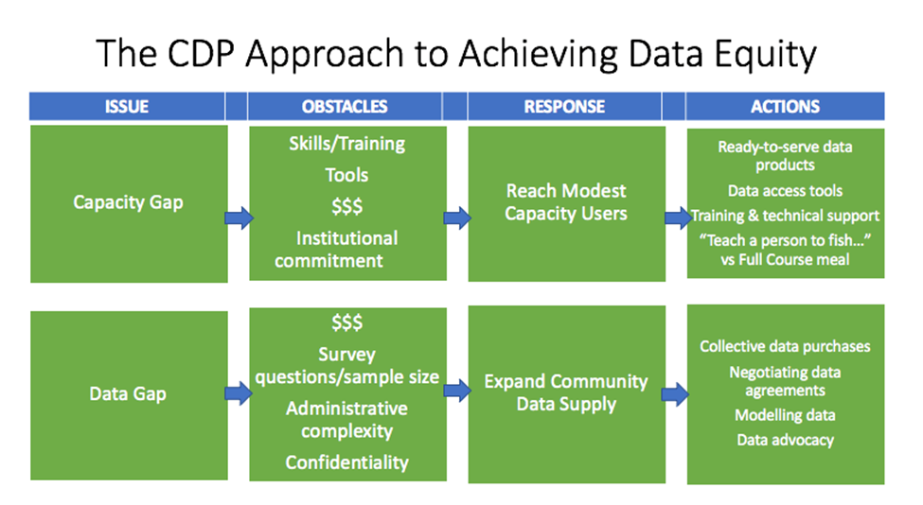
CDP Insight Generation Workshop

Slide 6
Solutions Lab Team
Canadian Community Economic Development Network/CDP Team: Project leader, integration of Solutions Lab activities into CDP workplan including data acquisition, data visualisation and access, data advocacy
Priority Decision Data Inc.: Input to indicator framework, output development and evaluation in collaboration with Community Partners.
Lansdowne Technologies Inc.: Solutions Lab Consultant
Community Economic Development Corporation (CDEC) de Québec: CCEDNet member facilitating Quebec participation

Slide 7
Community Data Lab – Governance Structure
A clearly defined governance model and appropriate leadership has been established to support activities and to sustain momentum over time.
Stakeholders
Local Delivery Teams (Community Partner – Micro Labs)
Organizations and people who are part of the system. They would use data to make more informed decisions or are people with lived experience who are impacted by decision making.
Stakeholders provide input in different ways throughout the lab (respond to surveys, participate in local sessions, participate in national sessions, review documents and provide input, etc.)
Some of the stakeholders will be local and or national data lab participants.
Accountable for local engagement activities to generate ideas and insights
Participate in National engagement activities
Participants may also provide technical subject matter expertise for the Lab.
Project Team
Working Group (National)
Accountable for innovation lab design, decision-making, project management, stakeholder collaboration and engagement design, communications, evaluation, fund development, budget oversight, and design and implementation of the Lab activities.
Taking the form of a CDP Working Group, accountable for providing strategic lab guidance, reviewing overall progress and recommendations, facilitating issue management, and providing insights on recommendations.
Notes:
Clarify the expected outputs for each group from the lab.

Slide 8
Sample of Community Participants
Hastings & Prince Edward Counties Community Data Consortium (Hastings County ON)
Kingston Frontenac Lennox & Addington Community Data Consortium (City of Kingston)
Toronto Community Data Consortium (City of Toronto, Social Development, Finance & Administration Division)
Northern Ontario Community Data Consortium (Northern Policy Institute)
Calgary Community Data Consortium (City of Calgary Neighbourhoods Division)
Bow Valley Community Data Consortium (Town of Banff)
Northern Alberta Community Data Consortium (Regional Municipality of Wood Buffalo)
British Columbia communities (Social Planning & Research Council BC)

Slide 9






CTLabs | The Lansdowne Group | 1
Community Data Lab: Solutions Lab Phases
This solutions lab project seeks methodological innovation in data collection, analysis and presentation. This leverages many other elements of housing solutions: increasing initial understanding of problems and how they are related; supporting evidence-based consensus on solutions; assessing end results for accountability; and identifying further innovation opportunities.
Definition Discovery Development Prototype & Test Roadmap
Establish the scope of the lab and reframe the issue.
Generate insight through big data and user insight, understand the current state of the issue based on a range of research methodologies.
Co-develop new ideas through Solutions Lab stakeholder input.
Test and refine shared ideas and multiple potential solutions.
Communicate a clear path to realize the preferred solution, and to solution uptake and replication.
3
Lab Phases
1
4
5
2
Nov - Dec 2020 (2 months) | Dec 2020 – March 2021 (4 months) | April - Sept 2021 (6 months) | Oct - Dec 2021 (3 months) | Jan – March 2022 (3 months)
Confirm participants;
Negotiate contracts;
Detail work plan;
Confirm workarounds and opportunities for COVID-19 impacts on project activities; and,
Revisit the originally stated Problem Brief
Undertake research and survey stakeholders to determine priority housing & related urbanization/local development challenges, data gaps, and opportunity costs of missing data;
Analyze results and report back to participants;
Identify organizations who use housing and NHS priorities related data at a local level to ensure the “system” is engaged
Prepare initial stakeholder engagement packages, comprising overarching questions for data sets, and devising how complex community data sets can be meshed with local priorities
National level ideation session for local partners.
Local engagement of stakeholders in design charettes/workshops;
National and local engagement sessions to share ideas and confirm prototypes;
Prepare prototypes for dissemination including designs for new data sets and/or new ways of organizing and presenting existing data, new and modified presentation graphics, including story boards for infographics and short videos; and,
Prepare communication packages for distribution to participants and trial groups.
Engage participants in design charettes/workshops,
Test and refine phase 3 prototypes for new data sets, indicators, communication tools, stories with user audiences
Follow-up survey all stakeholders;
Lessons learned roundtable with senior CMHC and Statistics Canada officials, consortium leaders, and members of the Canadian Housing Policy Roundtable
Preparation of roadmap document designed to move project results from concept to impact.
Main Activities
Notes:
Coordinating national and local (micro) level innovation
A national Solutions Lab hosted by the CDP and led by the project team will coordinate with a network of local “micro-labs” led by CDP members and supported by the national project team.
The National Solutions Lab will take the form of a CDP working group, relying on scheduled AdobeConnect meetings serving as training and learning workshops informed by a Solutions Lab innovation process.
Community Data Micro Labs will rely on member-led processes and will guide the preparation of project outputs to ensure their relevance to local trends and conditions.
Micro Labs will share certain core characteristics, including convening local stakeholders focused on the topic of housing and seeking to make better use of data to inform local decision making While each Micro Lab will be unique, they will be expected to align with the Solutions Lab problem statement, rely on the innovation methodologies provided by the Solutions Lab project team, and share reports and findings with the National Lab.

Slide 10
Discovery Phase
Research
University of Waterloo
Survey
National Lab

Slide 11
Discovery results

Slide 12
Discovery results: Survey

Slide 13
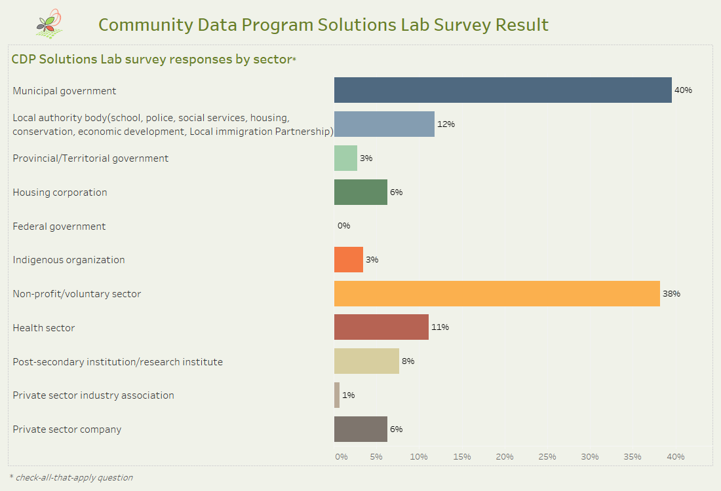

Slide 14
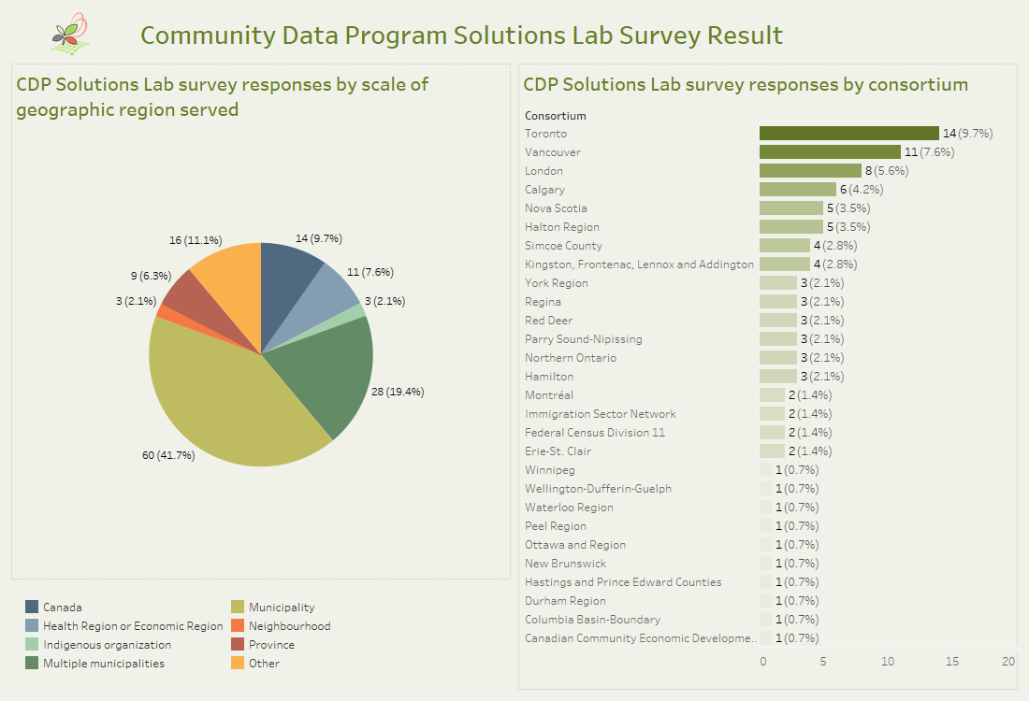

Slide 15
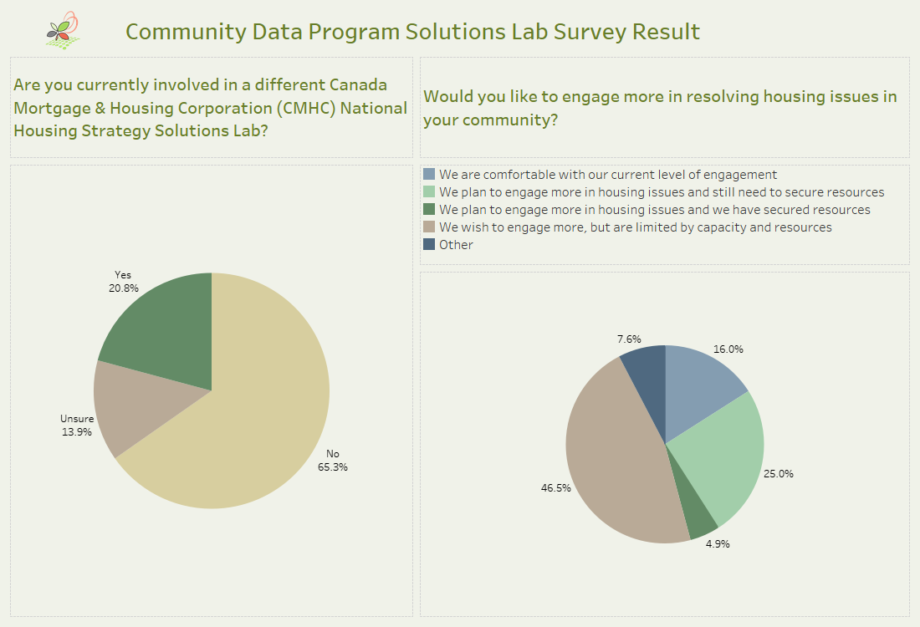

Slide 16
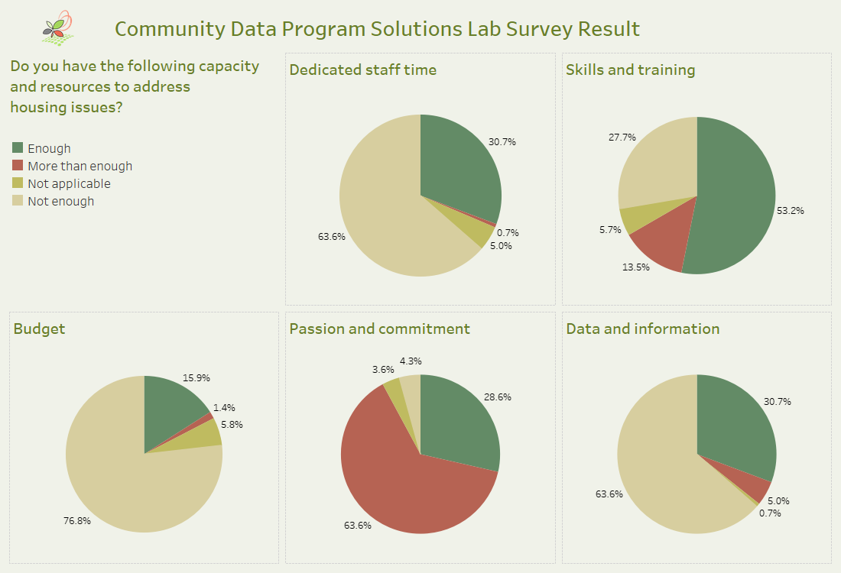

Slide 17
Discovery results: National Lab

Slide 18
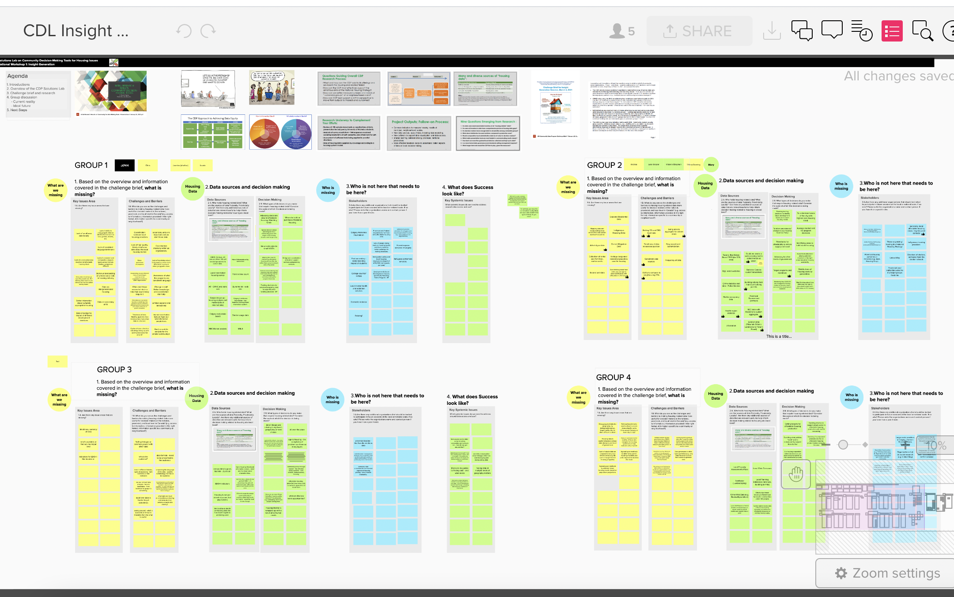
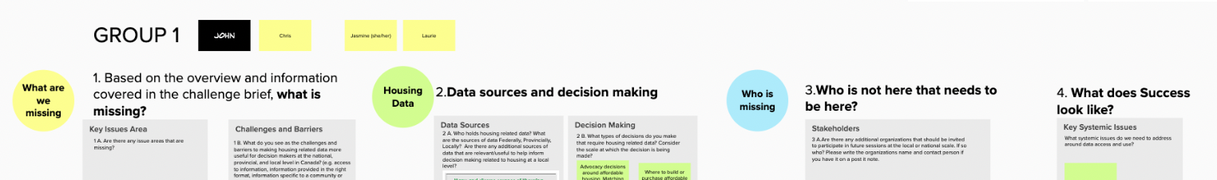
Mural Board from National Lab, March 2

Slide 19
Discovery results: University of Waterloo

Slide 20
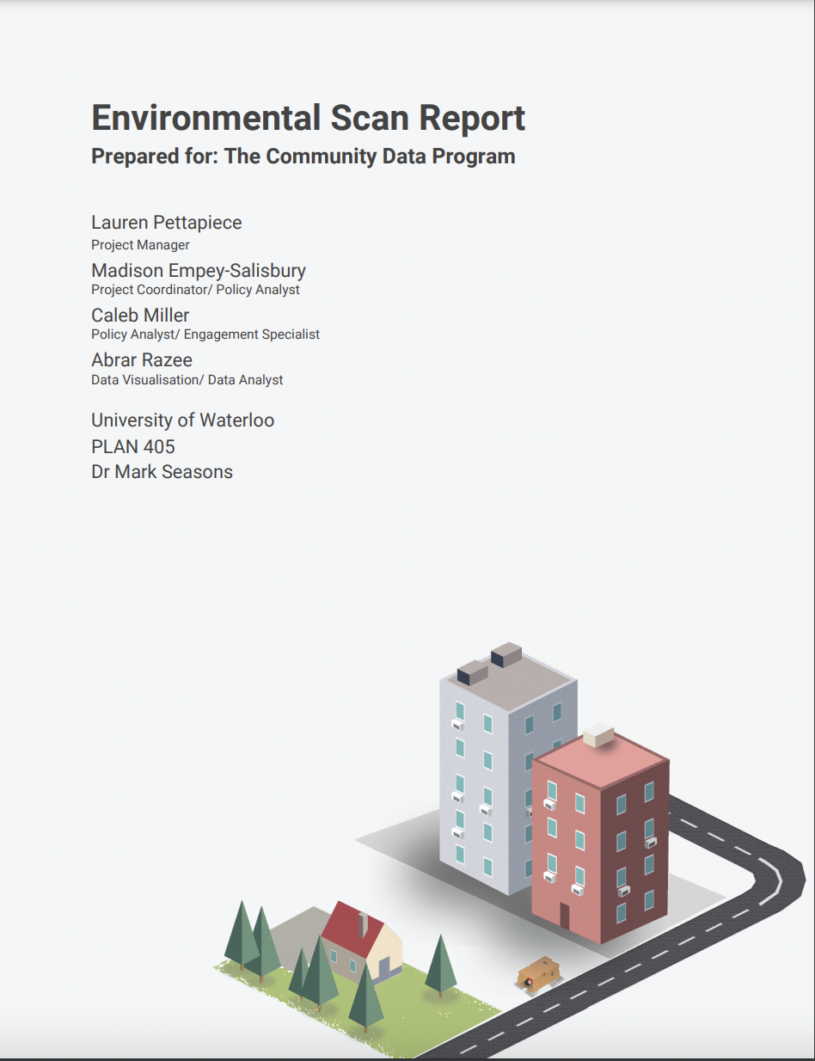
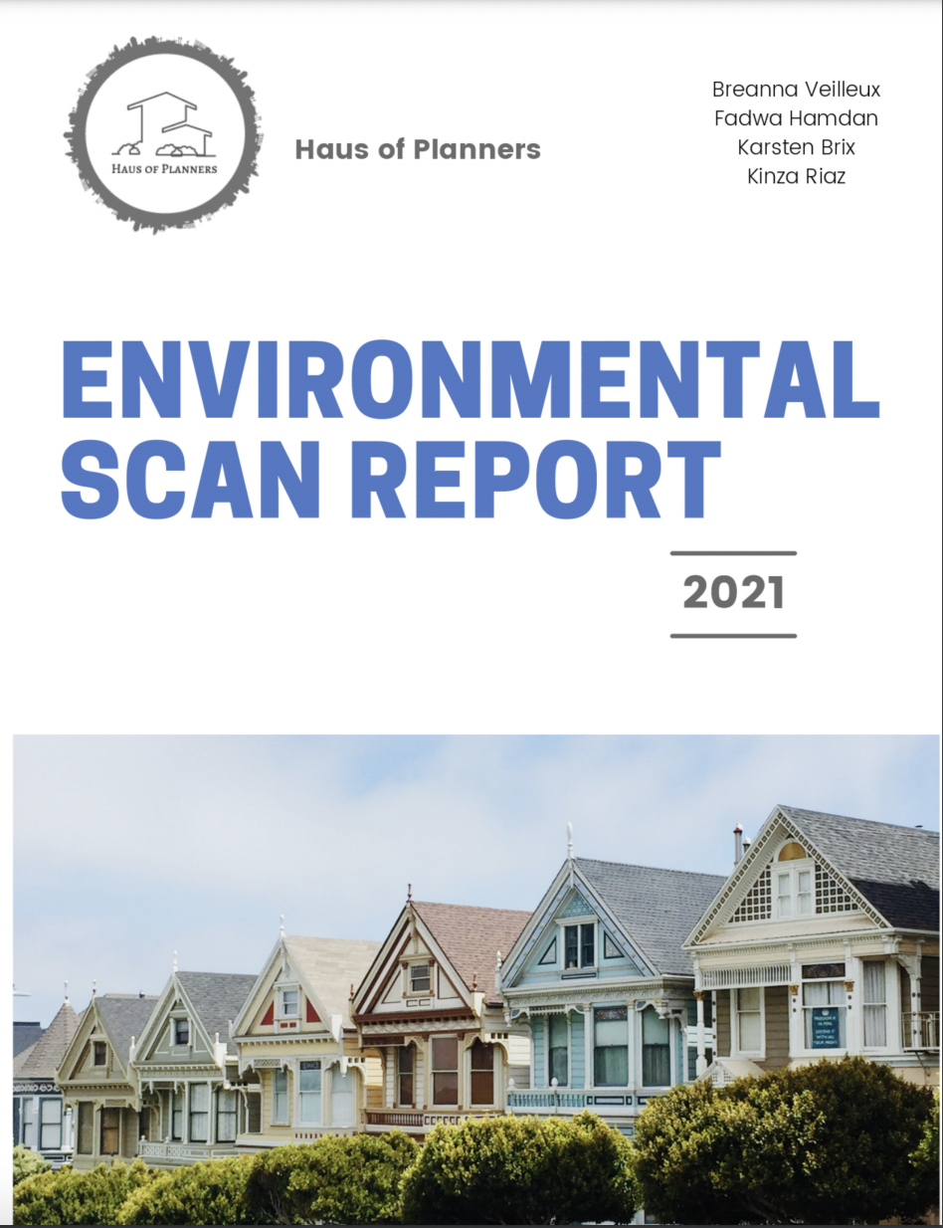
University of Waterloo

Slide 21
Discovery results: Overall

Slide 22
Discussion of Results
Notes:
John to set stage for exercise
Ask each group facilitator to share 2-3 insights from their breakout group

Slide 23
Questions for the Project Team
What are you most excited about from the conversation so far?
Who is missing from the conversation? How will they be brought in?
What are you looking forward to during the next phase?
What does success look like?

Slide 24
Questions for Today’s Participants
What housing data question/problem do you want us to solve for you?

Slide 25
Sample CDP Dashboard

Slide 26
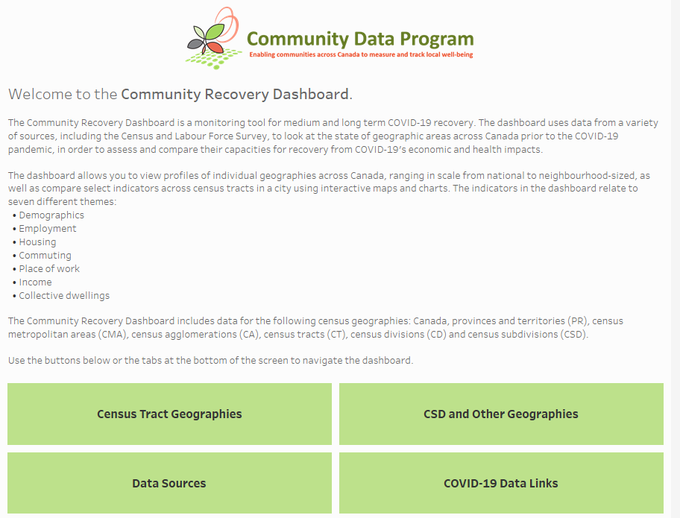
Sample dashboard
Community recovery dashboard
What could a Housing Data dashboard include?

Slide 27
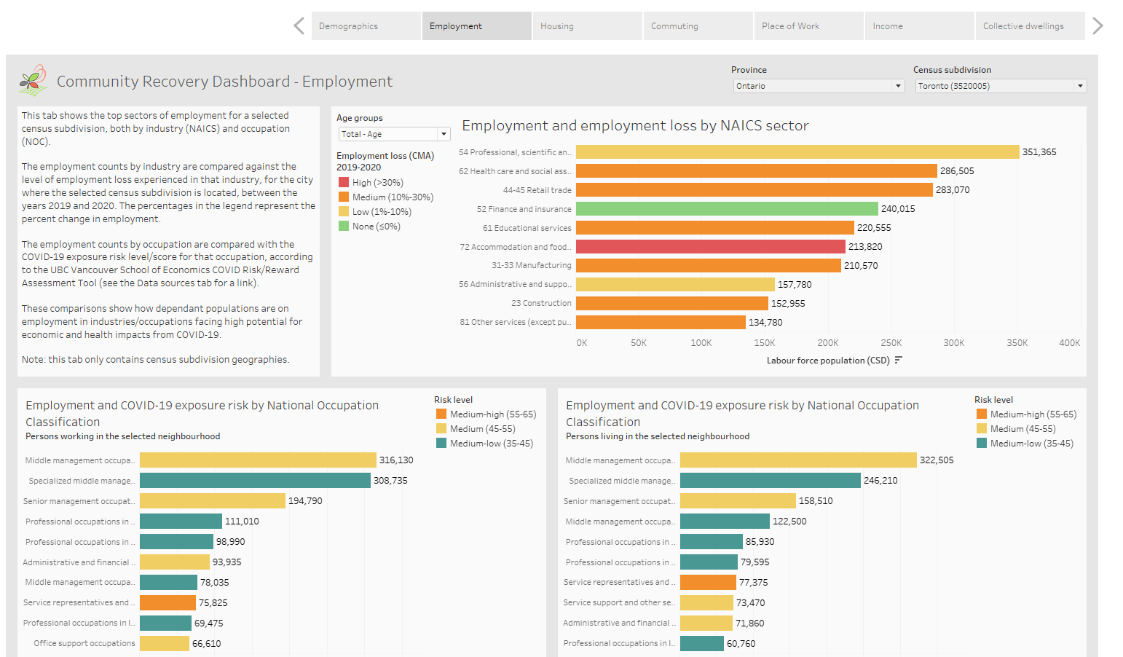

Slide 28
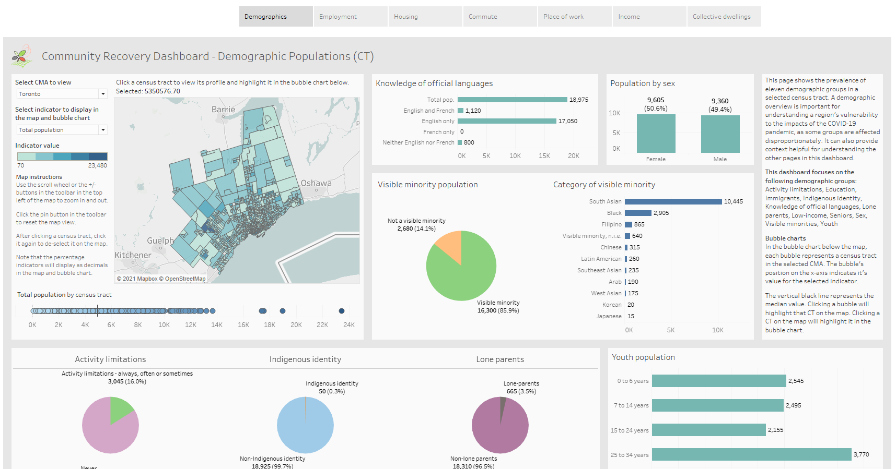

Slide 29
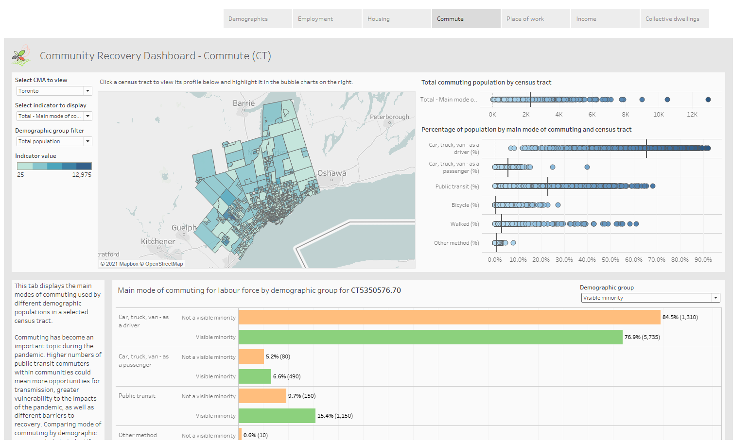

Slide 31
Next steps
Different ways to be involved
Notes:
Ask each group facilitator to share 2-3 insights from their breakout group

Slide 32
Next Steps
National session to share ideas from local microlabs & confirm prototyping approach
Lessons Learned Roundtable / Road map engagement session
National Insight Generation Workshop
To Be Confirmed
22 Apr. 2021
14 Sep. 2021
7 Dec. 2021
8 Mar. 2022
2 Mar. 2021
15 June 2021
9 Nov. 2021
8 Feb. 2022
National level ideation session followed by microlabs engagement of local stakeholders ideation sessions
Prototyping activities workshop
Sharing project results and transition to post-project implementation
To Be Confirmed

Slide 33
Participate in the Solutions Lab
National Level Ideation Session, April 22, 2021
Micro labs
  Quebec
  Halton, ON
  Winnipeg, MB
  Toronto, ON

Slide 34

Visit
www.communitydata.ca
or
Send us an email at
information@communitydata.ca

