Slide 1



Solutions Lab on Community Decision-Making Tools for Housing Issues
National Insight Generation Workshop March 2, 2021

Slide 2
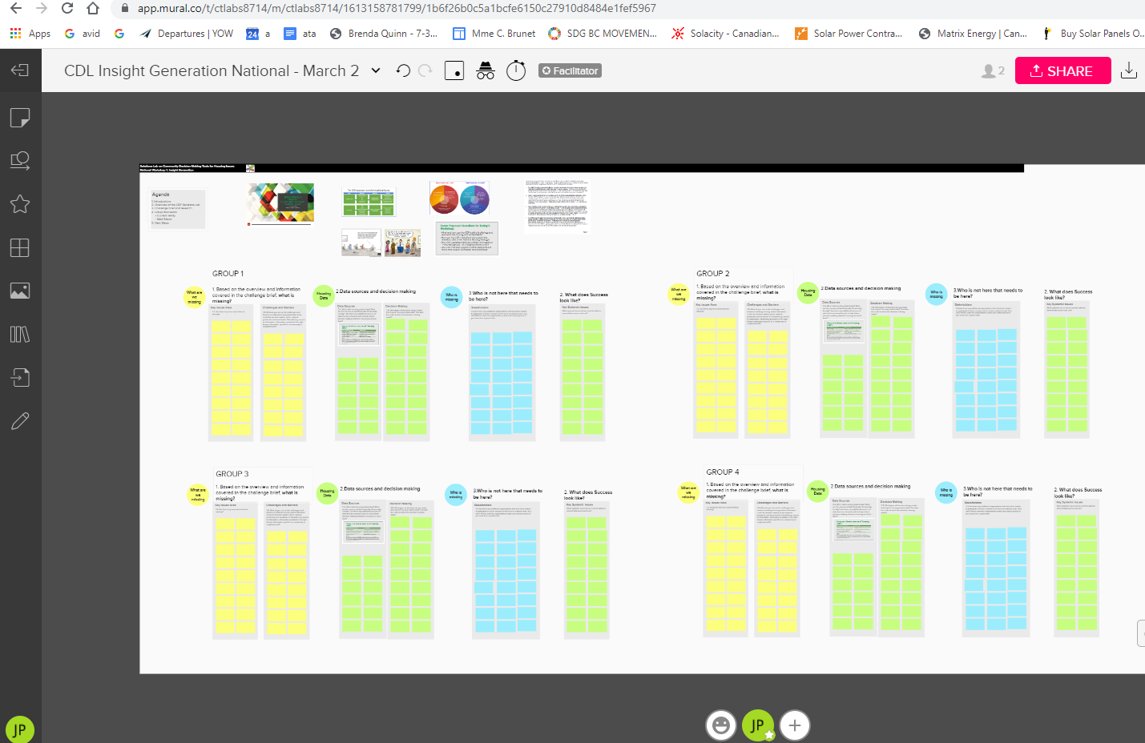
Welcome & Introductions
Adobe Connect
Mural
Add content
https://app.mural.co/t/ctlabs8714/m/ctlabs8714/1613158781799/1b6f26b0c5a1bcfe6150c27910d8484e1fef5967
Notes:
Mary - Brief Welcome and Adobe Technology orientation
Mural intro
Share Mural Link for GUESTS: https://app.mural.co/t/ctlabs8714/m/ctlabs8714/1613158781799/1b6f26b0c5a1bcfe6150c27910d8484e1fef5967

Slide 3
Overview of the CDP Solutions Lab

Slide 4






CTLabs | The Lansdowne Group | 1
Community Data Lab: Solutions Lab Phases
This solutions lab project seeks methodological innovation in data collection, analysis and presentation. This leverages many other elements of housing solutions: increasing initial understanding of problems and how they are related; supporting evidence-based consensus on solutions; assessing end results for accountability; and identifying further innovation opportunities.
Lab Phases
Definition Discovery Development Prototype & Test Roadmap
Establish the scope of the lab and reframe the issue.
Generate insight through big data and user insight, understand the current state of the issue based on a range of research methodologies.
Co-develop new ideas through Solutions Lab stakeholder input.
Test and refine shared ideas and multiple potential solutions.
Communicate a clear path to realize the preferred solution, and to solution uptake and replication.
3
1
4
5
2
Nov - Dec 2020 (2 months) | Dec 2020 – March 2021 (4 months) | April - Sept 2021 (6 months) | Oct - Dec 2021 (3 months) | Jan – March 2022 (3 months)
Main Activities
Confirm participants;
Negotiate contracts;
Detail work plan;
Confirm workarounds and opportunities for COVID-19 impacts on project activities; and,
Revisit the originally stated Problem Brief
Undertake research and survey stakeholders to determine priority housing & related urbanization/local development challenges, data gaps, and opportunity costs of missing data;
Analyze results and report back to participants;
Identify organizations who use housing and NHS priorities related data at a local level to ensure the “system” is engaged
Prepare initial stakeholder engagement packages, comprising overarching questions for data sets, and devising how complex community data sets can be meshed with local priorities
National level ideation session for local partners.
Local engagement of stakeholders in design charettes/workshops;
National and local engagement sessions to share ideas and confirm prototypes;
Prepare prototypes for dissemination including designs for new data sets and/or new ways of organizing and presenting existing data, new and modified presentation graphics, including story boards for infographics and short videos; and,
Prepare communication packages for distribution to participants and trial groups.
Engage participants in design charettes/workshops,
Test and refine phase 3 prototypes for new data sets, indicators, communication tools, stories with user audiences
Follow-up survey all stakeholders;
Lessons learned roundtable with senior CMHC and Statistics Canada officials, consortium leaders, and members of the Canadian Housing Policy Roundtable
Preparation of roadmap document designed to move project results from concept to impact.
Notes:
Coordinating national and local (micro) level innovation
A national Solutions Lab hosted by the CDP and led by the project team will coordinate with a network of local “micro-labs” led by CDP members and supported by the national project team.
The National Solutions Lab will take the form of a CDP working group, relying on scheduled AdobeConnect meetings serving as training and learning workshops informed by a Solutions Lab innovation process.
Community Data Micro Labs will rely on member-led processes and will guide the preparation of project outputs to ensure their relevance to local trends and conditions.
Micro Labs will share certain core characteristics, including convening local stakeholders focused on the topic of housing and seeking to make better use of data to inform local decision making While each Micro Lab will be unique, they will be expected to align with the Solutions Lab problem statement, rely on the innovation methodologies provided by the Solutions Lab project team, and share reports and findings with the National Lab.

Slide 5
Solutions Lab Team
Canadian Community Economic Development Network/CDP Team: Project leader, integration of Solutions Lab activities into CDP workplan including data acquisition, data visualisation and access, data advocacy
Priority Decision Data Inc.: Input to indicator framework, output development and evaluation in collaboration with Community Partners.
Lansdowne Technologies Inc.: Solutions Lab Consultant
Community Economic Development Corporation (CDEC) de Québec: CCEDNet member facilitating Quebec participation

Slide 6
Community Data Lab – Governance Structure
A clearly defined governance model and appropriate leadership has been established to support activities and to sustain momentum over time.
Stakeholders
Local Delivery Teams (Community Partner – Micro Labs)
Organizations and people who are part of the system. They would use data to make more informed decisions or are people with lived experience who are impacted by decision making.
Stakeholders provide input in different ways throughout the lab (respond to surveys, participate in local sessions, participate in national sessions, review documents and provide input, etc.)
Some of the stakeholders will be local and or national data lab participants.
Accountable for local engagement activities to generate ideas and insights
Participate in National engagement activities
Participants may also provide technical subject matter expertise for the Lab.
Project Team
Working Group (National)
Accountable for innovation lab design, decision-making, project management, stakeholder collaboration and engagement design, communications, evaluation, fund development, budget oversight, and design and implementation of the Lab activities.
Taking the form of a CDP Working Group, accountable for providing strategic lab guidance, reviewing overall progress and recommendations, facilitating issue management, and providing insights on recommendations.
Notes:
Clarify the expected outputs for each group from the lab.

Slide 7
Sample of Community Participants
Hastings & Prince Edward Counties Community Data Consortium (Hastings County ON)
Kingston Frontenac Lennox & Addington Community Data Consortium (City of Kingston)
Toronto Community Data Consortium (City of Toronto, Social Development, Finance & Administration Division)
Northern Ontario Community Data Consortium (Northern Policy Institute)
Calgary Community Data Consortium (City of Calgary Neighbourhoods Division)
Bow Valley Community Data Consortium (Town of Banff)
Northern Alberta Community Data Consortium (Regional Municipality of Wood Buffalo)
British Columbia communities (Social Planning & Research Council BC)

Slide 8
Problem Space
Problem Statement
“Without strong, accessible data, decision-makers can’t make the best decisions to address housing supply issues. We have lots of housing data, but
  housing data is scattered, outdated, inconsistent, and not openly available
  Housing Data if full of gaps – especially for vulnerable populations
  Data collection limitations, which impacts availability, relevancy, timeliness
  Data sharing limitations – legal, business, other constraints limit sharing
  Data governance challenges – clear governance and standardization is lacking
  And other challenges!
Community Data Lab Problem Statement
Municipal governments and community-based organizations want to make decisions based on relevant, credible data.
Currently, decision-makers may see housing data as the 'black-box' domain of specialists in academia, data management, or policy think tanks.
Unless there is deep and widespread real-time accessibility of a diverse range of outcomes-focused housing data, indicators, and decision guidance, risks of systemic failure will persist. That is the core decision-making problem to be addressed by this project.

Slide 9
Information leveling – Challenge Brief Overview
Preliminary Survey, Research Overview, Challenge Brief

Slide 10
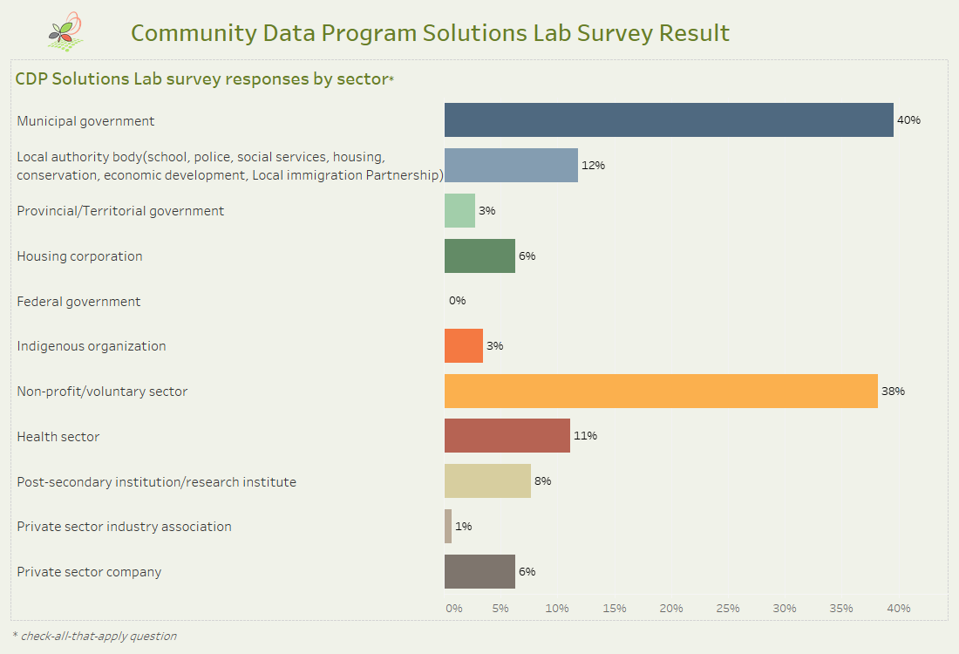

Slide 11
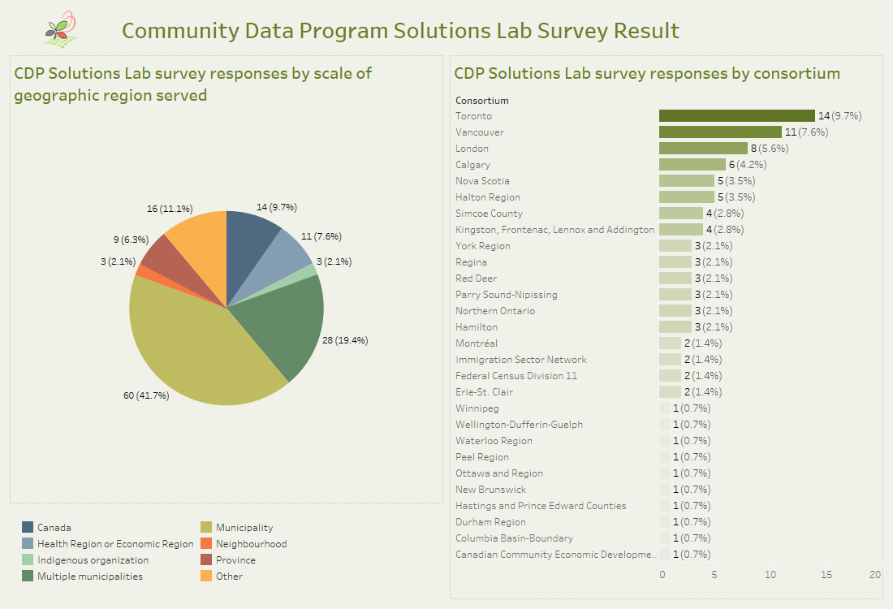

Slide 12
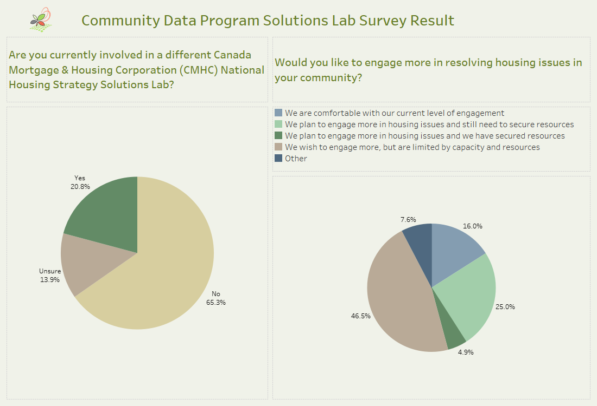

Slide 13
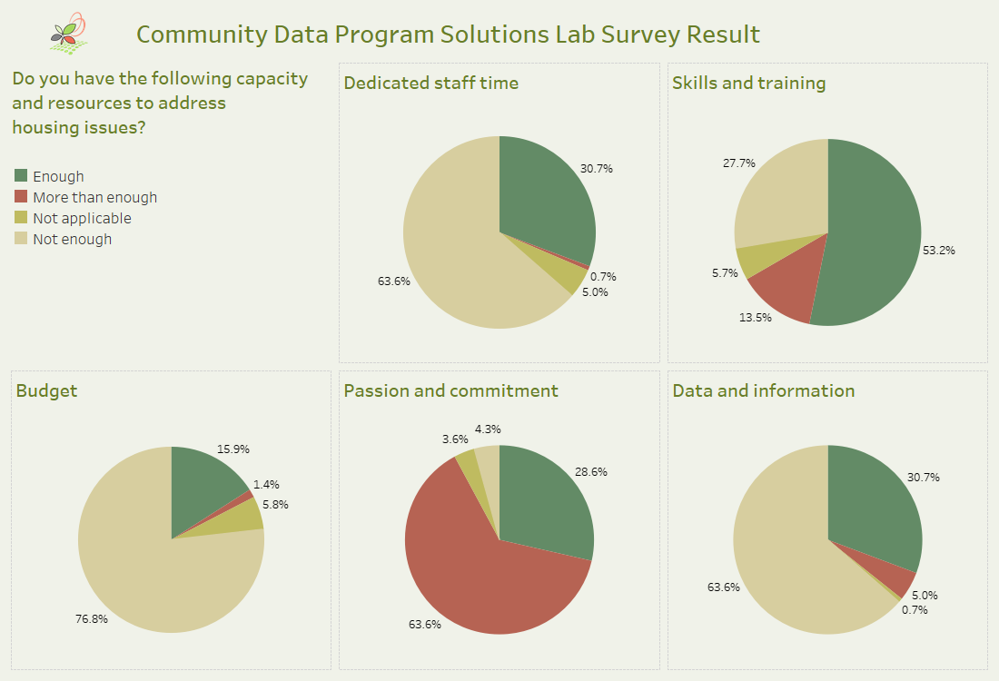

Slide 15

CDP Insight generation workshop:
Introduction to CDP Research Underway
C. David Crenna, CDP Project Team
March 2, 2021

Slide 16
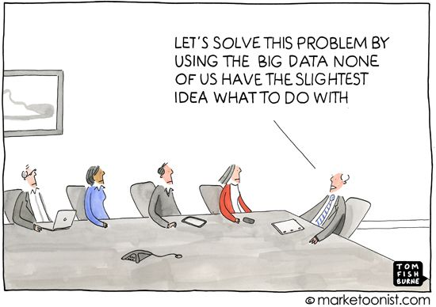

Slide 17
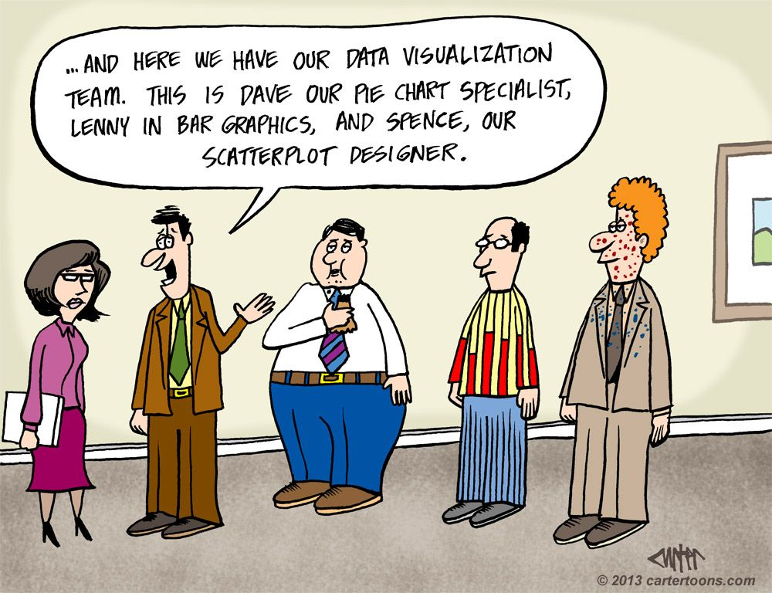

Slide 18
Questions Guiding Overall CDP Research Process:
What and how can the CDP add to its offerings and services in the housing and related fields?
How can the CDP most effectively support the ambitious aims of the National Housing Strategy?
How can we better measure numbers and needs of “vulnerable groups” at a neighbourhood scale?
How can CDP best support a shift in perspective to move from outputs to impacts and outcomes?

Slide 19
From outputs to impacts to outcomes

Slide 20
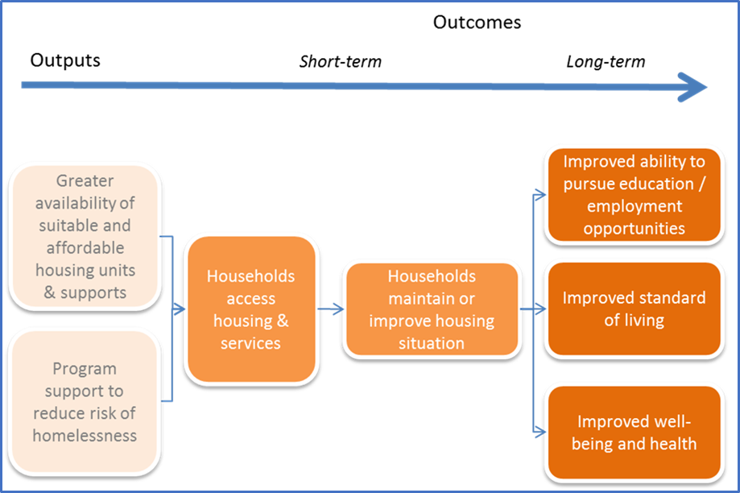
Outputs
Impacts
Outcomes

Slide 21
Managing multiple sources of data

Slide 22
Many and diverse sources of “housing data”:
Main Comprehensive Sources: | Scope of Outputs:
Statistics Canada | Housing characteristics of whole population
Canada Mortgage & Housing Corporation | Housing production; Core Housing Need
Employment and Social Development | Homelessness; social development issues
Canadian Real Estate Association | Housing prices, sales
Environics Analytics | Neighbourhood characteristics
Others:
Canadian Home Builders' Association (CHBA); BuildForce Canada; Natural Resources Canada (NRCan); Environment and Climate Change Canada; Health Canada; Immigration, Refugees and Citizenship Canada (IRCC); National Research Council Canada (NRC); Finance Canada; Bank of Canada; Canada Revenue Agency (CRA); Innovation, Science & Economic Development (ISED); Public Safety and Emergency Preparedness (PSEP); Canadian Urban Transit Association (CUTA)

Slide 23
Achieving data equity

Slide 24
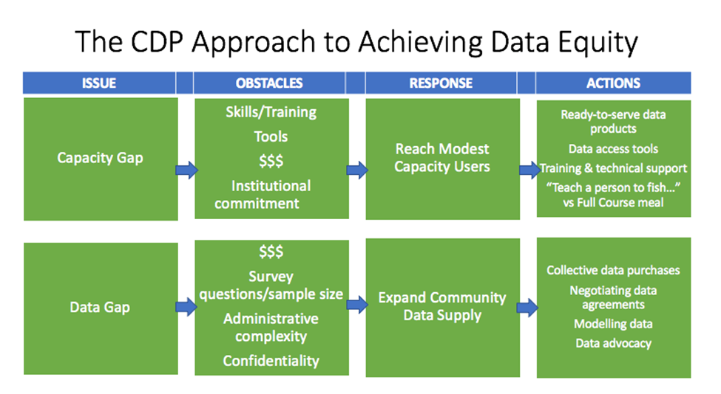

Slide 25
Applying data to multiple uses

Slide 26
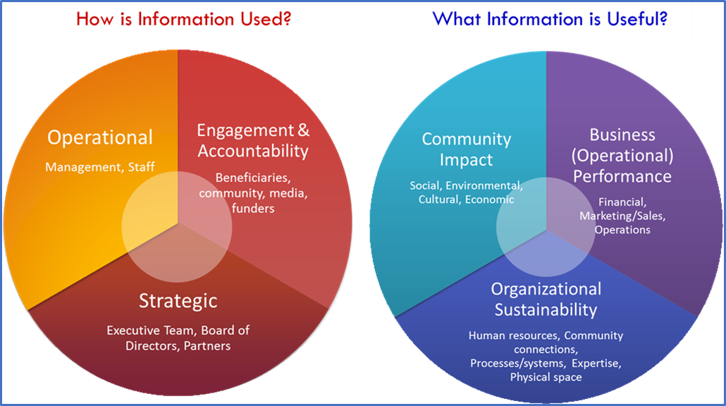

Slide 27
Intended outputs and follow-on process
Thank you!

Slide 28
Project Outputs; Follow-on Process:
Common indicators to measure housing results at municipal, neighbourhood scales.
New data sources, uses of data, including data modelling.
New software to support data visualization and data access.
Shared learning between/among provincial, territorial jurisdictions.
More effective feedback loops to understand better impacts of data on local decision making.

Slide 29
Research Underway to Complement Your Efforts:
Review of ~50 sample documents re: applications of data, presentation techniques by University of Waterloo students.
Analysis of survey results from ~144 responses received covering nearly 85% of CDP consortia, plus others new to CDP.
Assessment of software tools being applied in parallel situations.
Map of housing data suppliers by coverage according to a housing system model.

Slide 30
Sample CDP Dashboard

Slide 31
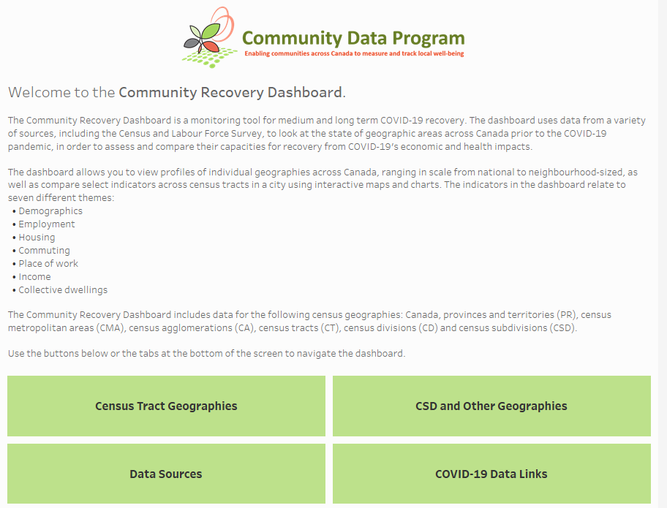
Sample dashboard
Community recovery dashboard
What could a Housing Data dashboard include?

Slide 32
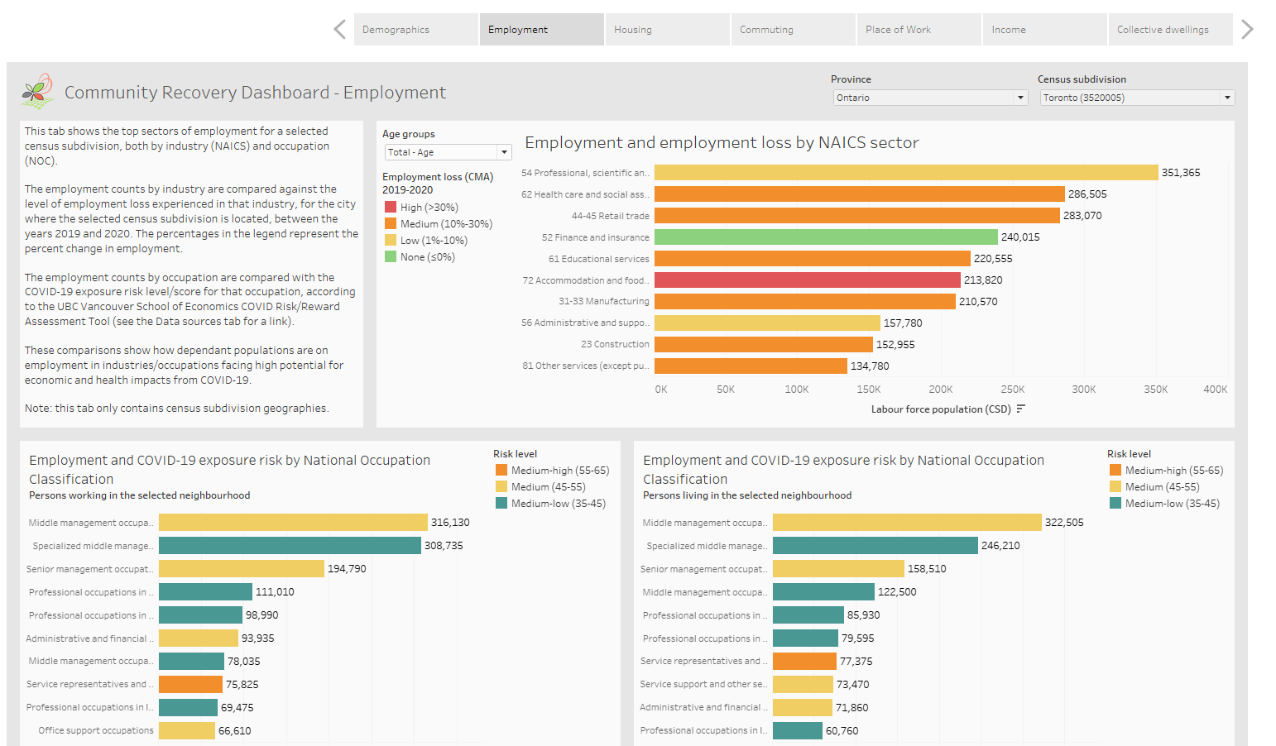

Slide 33
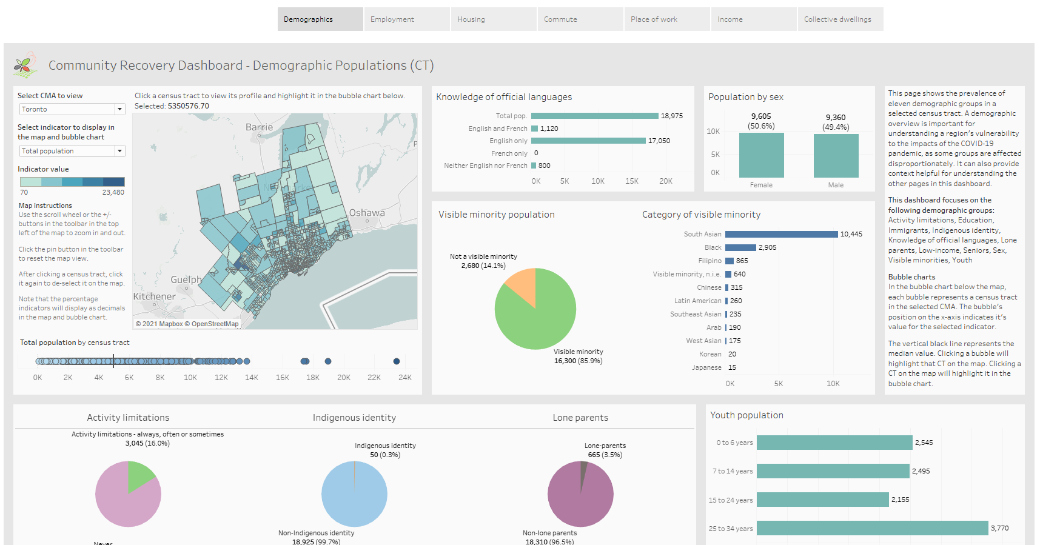

Slide 34
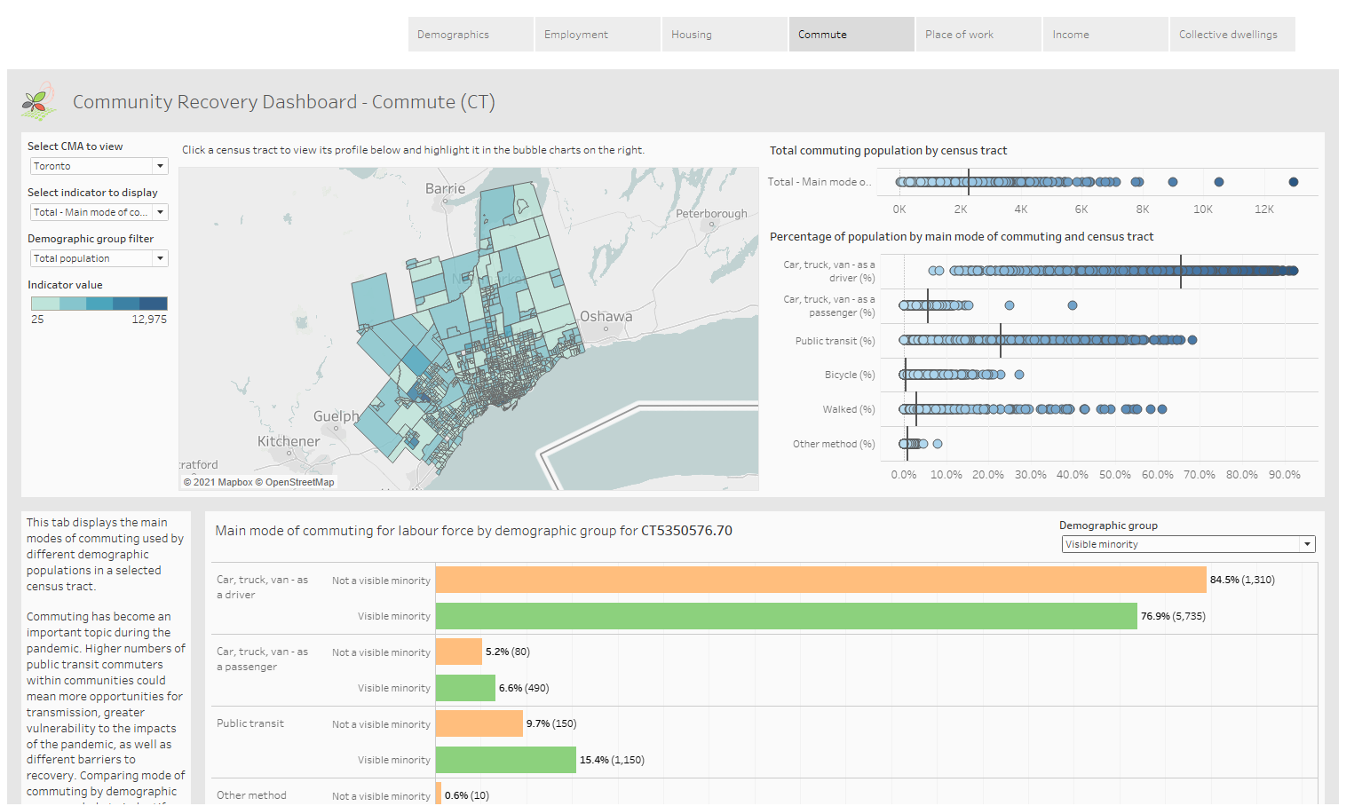

Slide 36
Group Discussion
Notes:
John to set stage for exercise
Ask each group facilitator to share 2-3 insights from their breakout group

Slide 37
4-5 break out groups.
Using Adobe Connect and Mural to facilitate group discussions. https://app.mural.co/t/ctlabs8714/m/ctlabs8714/1613158781799/1b6f26b0c5a1bcfe6150c27910d8484e1fef5967
Discuss questions in small groups.
Use the post it notes to share your ideas and suggestions
Questions:
Q1 Based on the overview and information covered in the challenge brief what is missing?
Q2 Data sources and decision making: Who holds housing related data? Who uses it? How do they use it?
Q3 Who else do you think we can invite to the table to help us better understand these issues and to help identify and prototype potential solutions.
Notes:
John to explain process.
Mary to create break out groups.

Slide 38
Debrief
Please share 2-3 highlights from each group discussion.
Notes:
Ask each group facilitator to share 2-3 insights from their breakout group

Slide 39
Next Steps
2 Mar. 2021
National Insight Generation Workshop
6 Apr. 2021
National level ideation session followed by microlabs engagement of local stakeholders ideation sessions
15 June 2021
National session to share ideas from local microlabs & confirm prototyping approach
14 Sep. 2021
Prototyping activities workshop
9 Nov. 2021
To Be Confirmed
7 Dec. 2021
To Be Confirmed
8 Feb. 2022
Lessons Learned Roundtable / Road map engagement session
8 Mar. 2022
Sharing project results and transition to post-project implementation

Slide 40

Visit
www.communitydata.ca
or
Send us an email at
information@communitydata.ca

