Slide 1
Solutions Lab on Community Decision-Making Tools for Housing Issues
National Level Ideation Session
April 22, 2021
Notes:
Michel - Opening remarks

Slide 2
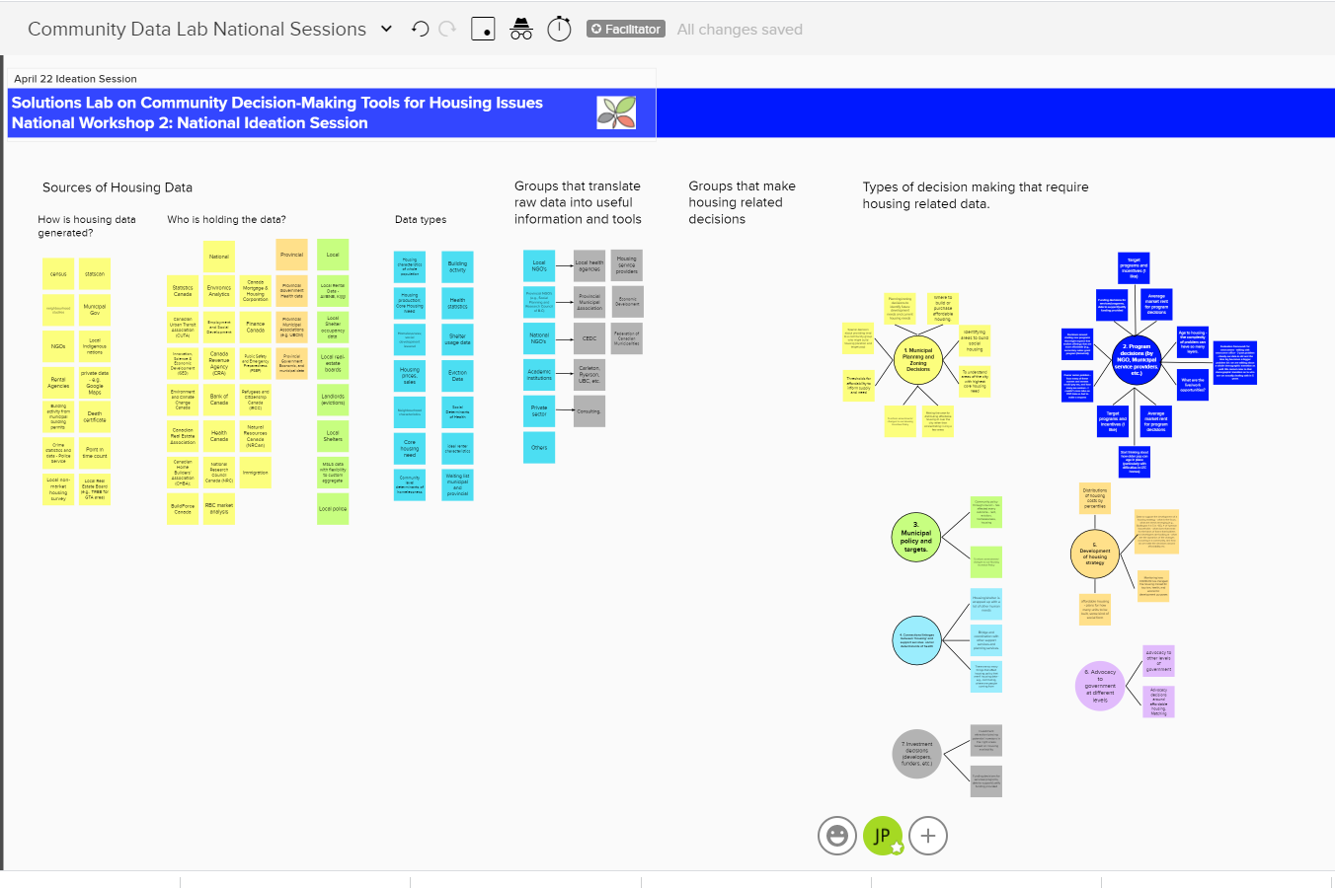
Welcome & Introductions
Adobe Connect
Mural
https://app.mural.co/t/ctlabs8714/m/ctlabs8714/1613158781799/1b6f26b0c5a1bcfe6150c27910d8484e1fef5967
Notes:
Mary - Brief Welcome and Adobe Technology orientation
- Mention that we will be using Mural again today. Share Mural Link for GUESTS: https://app.mural.co/t/ctlabs8714/m/ctlabs8714/1613158781799/1b6f26b0c5a1bcfe6150c27910d8484e1fef5967

Slide 3
Agenda and Objectives
Agenda
Objectives
Introductions
Review
Key insights from March, Survey, Interviews
New research
Idea Generation
Prioritization of ideas
Next Steps
Microlabs activities
June Session
Provide a brief overview of the output from the National Insight Generation Workshop, research and interviews
Review and discuss potential solutions/ideas to help address challenges and barriers
Prioritize potential solutions
Clarify next steps for micro labs and prototypes.
Notes:
Mary - Brief Welcome and Adobe Technology orientation
Mural intro
Share Mural Link for GUESTS: https://app.mural.co/t/ctlabs8714/m/ctlabs8714/1613158781799/1b6f26b0c5a1bcfe6150c27910d8484e1fef5967

Slide 4
Problem Space
Problem Statement
“Without strong, accessible data, decision-makers can’t make the best decisions to address housing supply issues. We have lots of housing data, but
housing data is scattered, outdated, inconsistent, and not openly available
Housing Data if full of gaps – especially for vulnerable populations
Data collection limitations, which impacts availability, relevancy, timeliness
Data sharing limitations – legal, business, other constraints limit sharing
Data governance challenges – clear governance and standardization is lacking
And other challenges!
Community Data Lab Problem Statement
Municipal governments and community-based organizations want to make decisions based on relevant, credible data.
Currently, decision-makers may see housing data as the 'black-box' domain of specialists in academia, data management, or policy think tanks.
Unless there is deep and widespread real-time accessibility of a diverse range of outcomes-focused housing data, indicators, and decision guidance, risks of systemic failure will persist. That is the core decision-making problem to be addressed by this project.
Notes:
Reminder of the problem statement

Slide 5
Where are we in the process?
2 Mar. 2021
National Insight Generation Workshop
22 Apr. 2021
National level ideation session followed by microlabs engagement of local stakeholders ideation sessions
15 June 2021
National session to share ideas from local microlabs & confirm prototyping approach
14 Sep. 2021
Prototyping activities workshop
9 Nov. 2021
To Be Confirmed
7 Dec. 2021
To Be Confirmed
8 Feb. 2022
Lessons Learned Roundtable / Road map engagement session
8 Mar. 2022
Sharing project results and transition to post-project implementation
Notes:
A quick reminder

Slide 6
Review Of Key insights
Notes:
Mary to provide an quick review of key insights from March session, research, and interviews.
Student research. 5 min summary

Slide 7
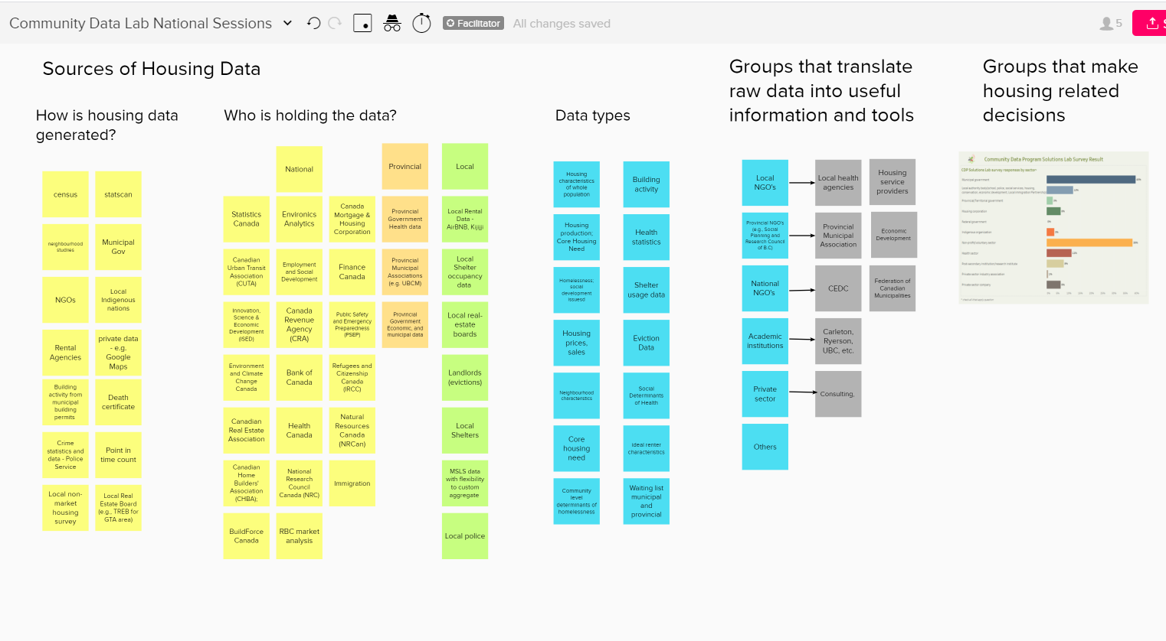
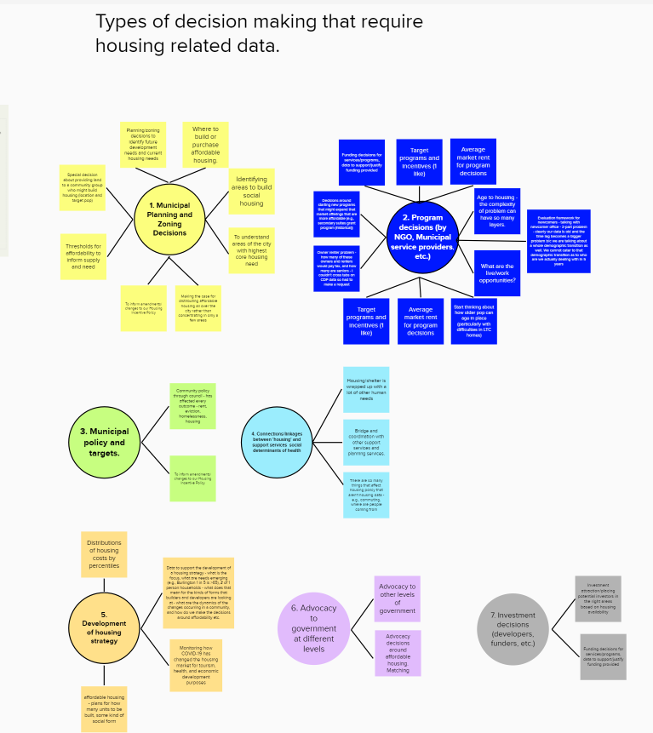
Summary from National Lab, March 2nd

Slide 8
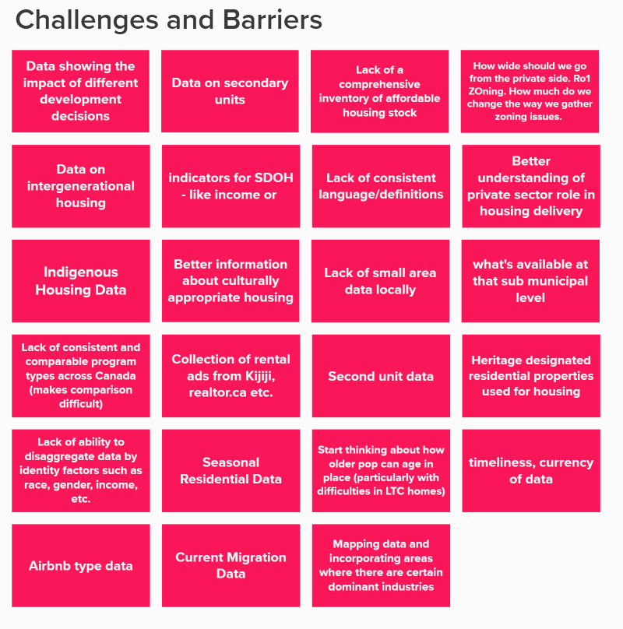
Challenges and Barriers
Highlight from March 2nd
Highlight from Interviews and Research
Consistency of data
Capacity to use data is a consistent obstacle.
Consistent tools to help with data
Smaller orgs don’t have the capacity.
CMHC surveys don’t reach the municipal and regional level
CMHC data is not robust enough - sample sizes are small and you have to take them with a grain of salt
Stats can census is 5 years old
It takes a long time to get new software installed

Slide 9
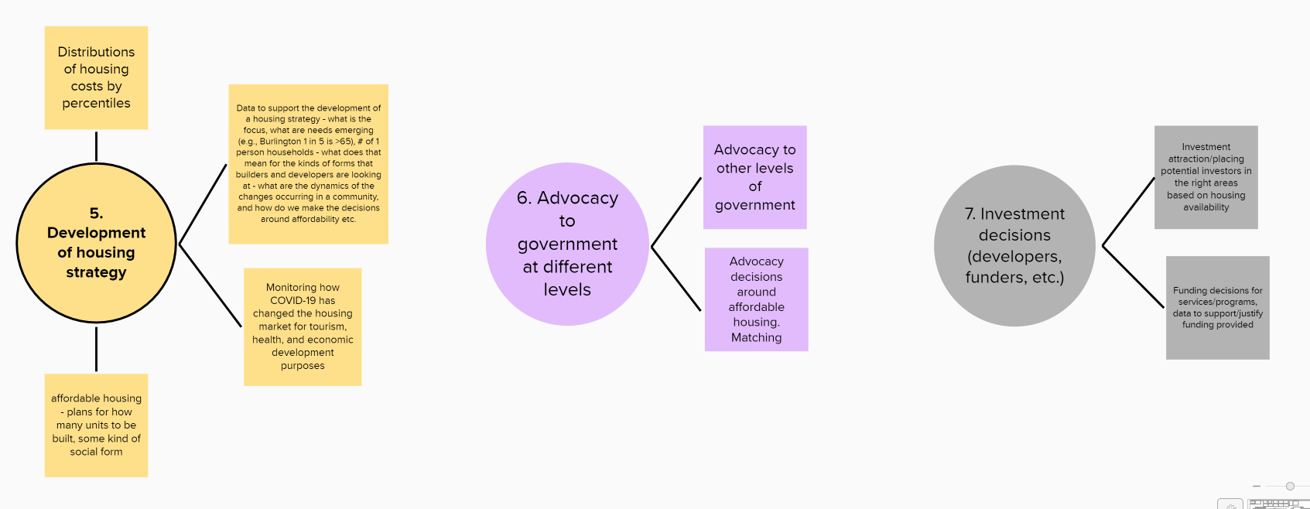
Types of decision making that require housing related data.

Slide 10
Highlights from March and Interviews
Interview highlights
Data cleaning: Standardize data (formatted well: geography, field headings, etc)
Having disaggregated data: socio-economic characteristics: LGBTQ community, Gender identity, disabilities, Race ethnicity
Triangulation, using multiple data sets to get at the information
Many communities don’t have capacity.
CMHC data is not robust enough: need municipal level data by zone, region, postal code
Success = better access to more comprehensive national and local data on a regular basis.

Slide 11
Discovery results: University of Waterloo

Slide 12
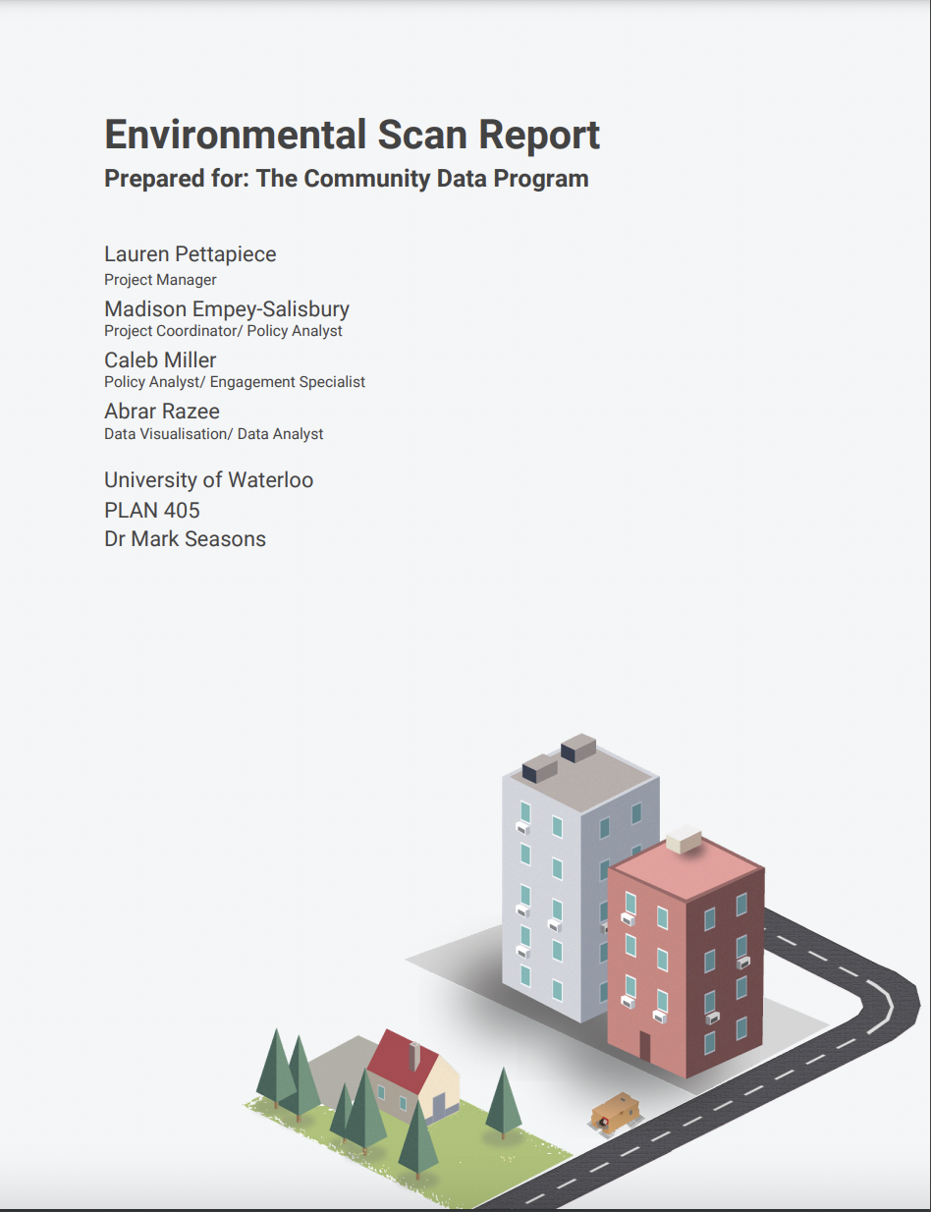
University of Waterloo

Slide 13
Idea Generation
Notes:
Start at 2:10
John to set stage for exercise
Ask each group facilitator to share 2-3 insights from their breakout group

Slide 14
Break out group discussion
Introduce yourselves and select a rapporteur who will share a summary of your discussion with the larger group.
Take 5 minutes by yourself to write down/brainstorm 7-10 potential solutions (one per note) that respond to the following question:
Based on your understanding of the issues and challenges, what are the potential solutions that you envision? Group them based on the structure provided.
Please write your responses on a post it note on Mural in your groups section.
In your group share your ideas with each other and group common themes in Mural.
Discuss the ideas and as a group select 3-5 of the best ideas that you believe will help address the issues/challenges.
Each group rapporteur will be asked to share the 3-5 best ideas (potential solutions) with the larger group.
Notes:
Mary - Ask each group rapporteur to share their top 2-3 potential solutions from their breakout group.
John help cluster ideas in Mural and set up for voting session

Slide 15
IDEATION RULES!
Defer judgment. There are no bad ideas at this point. There will be plenty of time to judge ideas later.
Encourage wild ideas. It’s the wild ideas that often create real innovation. It is always easy to bring ideas down to earth later!
Stay focused on the topic. You will get better output if everyone is disciplined. (we are looking at supply and access)
Be visual. Try to engage the logical and the creative sides of the brain.
Go for quantity. Set a big goal for the number of ideas and surpass it! Remember that there is no need to make a lengthy case for your idea since no one is judging. Ideas should flow quickly.
No killer phrases: That will never work; this has NEVER been done before; It’s not affordable…

Slide 16
Ideation warm-up
CRAZY IDEAS!
Based on your understanding of the issues and challenges, what are the potential solutions that you envision?
How might we access and use a diverse range of outcomes-focused housing data, indicators and decision guidance to help improve decision-making?
Ideas we can steal (or borrow with PRIDE!)
What has been done elsewhere that we might want to try?
Notes:
Take 5 minutes by yourself to write down/brainstorm 7-10 potential solutions (one per note) that respond to the following question:
Based on your understanding of the issues and challenges, what are the potential solutions that you envision?

Slide 17
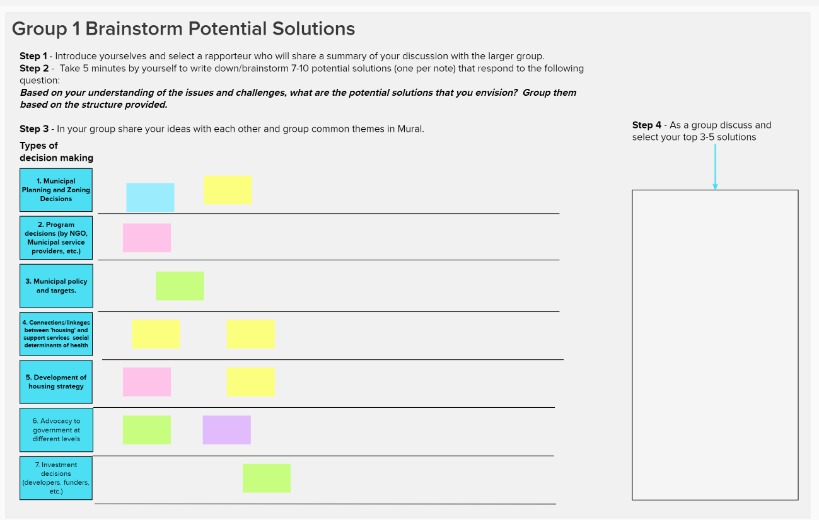
4-5 break out groups.
Using Adobe Connect and Mural to facilitate group discussions. https://app.mural.co/t/ctlabs8714/m/ctlabs8714/1613158781799/1b6f26b0c5a1bcfe6150c27910d8484e1fef5967
Facilitatory will go through the questions
Notes:
John to explain process.
Mary to create break out groups.

Slide 19
Summary and Preferred Solutions
Please share your top 2-3 solutions from each group discussion.
Notes:
Ask each rapporteur to share 2-3 insights from their breakout group

Slide 20
Summary and Prioritization
Each groups rapporteur will be asked to share their groups top 3-5 solutions in Mural.
In Mural everyone will receive 5 votes, which they can use to select their preferred solutions.
You can put all your votes on one idea or on 5 different solutions.
If you are not able access mural please share your selection with your group facilitator through the chat function in Adobe.
Notes:
2:50-3:10

Slide 21
Next steps

Slide 22
Next Steps
2 Mar. 2021
National Insight Generation Workshop
22 Apr. 2021
National level ideation session followed by microlabs engagement of local stakeholders ideation sessions
15 June 2021
National session to share ideas from local microlabs & confirm prototyping approach
14 Sep. 2021
Prototyping activities workshop
9 Nov. 2021
To Be Confirmed
7 Dec. 2021
To Be Confirmed
8 Feb. 2022
Lessons Learned Roundtable / Road map engagement session
8 Mar. 2022
Sharing project results and transition to post-project implementation

Slide 23
Visit www.communitydata.ca
or
Send us an email at information@communitydata.ca

Slide 24
Additional slides from April 8th

Slide 25
Discovery results: Overall

Slide 26
Main Topics:
(1) NHS Indicators for Canada as a Whole?
(2) Global/Canada-Wide Trends re: Housing Impacts?
(3) “Housing Continuum” as Data/Indicators Framework?
(4) Housing Demand/Supply Balance Indicators?
(5) Measures of Existing Housing Stock?
(6) Most Strategic Community-Level Geographies?
(7) Tools to Increase Data Usability?

Slide 27
(1) NHS Indicators for Canada as a Whole
Priority Areas for Action
Priority Groups
Targets for Canada as a Whole
Tracking Indicators

Slide 28
(1A) Priority Areas for Action:
Housing for those in greatest need - vulnerable populations
Social housing sustainability
Indigenous housing
Northern housing
Sustainable housing and communities
A balanced supply of housing

Slide 29
(1B) Priority Groups:
Women and children fleeing domestic violence
Seniors
Indigenous peoples
Homeless people
People with disabilities
Those dealing with mental health and addiction issues
Veterans
Young adults
Racialized groups
Newcomers

Slide 30
(1C) Targets for Canada as a Whole:
Cutting chronic homelessness by 50%
Removing 530,000 families from housing need
Renovating and modernizing 300,000 homes
Building 125,000 new homes

Slide 31
(1D) Tracking Indicators:
Homelessness is reduced year-over-year.
Housing is affordable and in good condition.
Affordable housing promotes inclusion for individuals and families.
Housing outcomes in Canada’s territories are improved.
Housing needs of Indigenous groups are identified and improved.
Affordable housing contributes to environmental sustainability.
National Housing Strategy contributes to Canadian economic growth.
Partnerships are built, strengthened, mobilized to achieve outcomes.
Collaboration/alignment across the federal government.

Slide 32
(2) Global/Canada-Wide Trends – Housing
Global Climate Change – Community Natural Disaster Risk Reduction; Housing Performance
Global Pandemic Risk Reduction – Neighbourhood, Dwelling Health Promotion, Risk Reduction
Population Aging, Immigrant-Driven Growth – Age-Friendly Communities; Welcoming Communities
Technological Change – Direct, Indirect Impacts on Community Economic and Social Futures
Drive for Greater Social, Sexual, Racial, & Income Equality; the “Rights Agenda” - Housing Affordability, Neighbourhood Integration

Slide 33
(3) “Housing Continuum” Framework

Slide 34
(4) Housing Demand/Supply Balance:

Slide 35
(5) Measures of Existing Housing Stock
New construction – completions?
Additions to existing units, accessory suites?
Conversions from non-residential to residential uses?
Demolitions without replacement, net loss?
Shift in price and value range?
Vacancy chains and long-term vacancies?

Slide 36
(6) Most Strategic Community-Level Geographies
Municipalities, neighbourhoods in rapid-growth urban regions?
Rural/small town areas?
Leadership of all geographic areas undergoing stress, regardless of size?
Planning ministries of provincial/territorial governments?
Federal funding sources for housing, infrastructure programs?

Slide 37
(7) Tools to Increase Data Usability
Artificial Intelligence to turn data into illustrated stories?
Data presentation templates, with auto-fill capacities?
Data-scraping and cleaning tools?
Administrative data capture, database creation tools, especially using small-area data used for roll-ups?

Slide 38
Sample CDP Dashboard

Slide 39
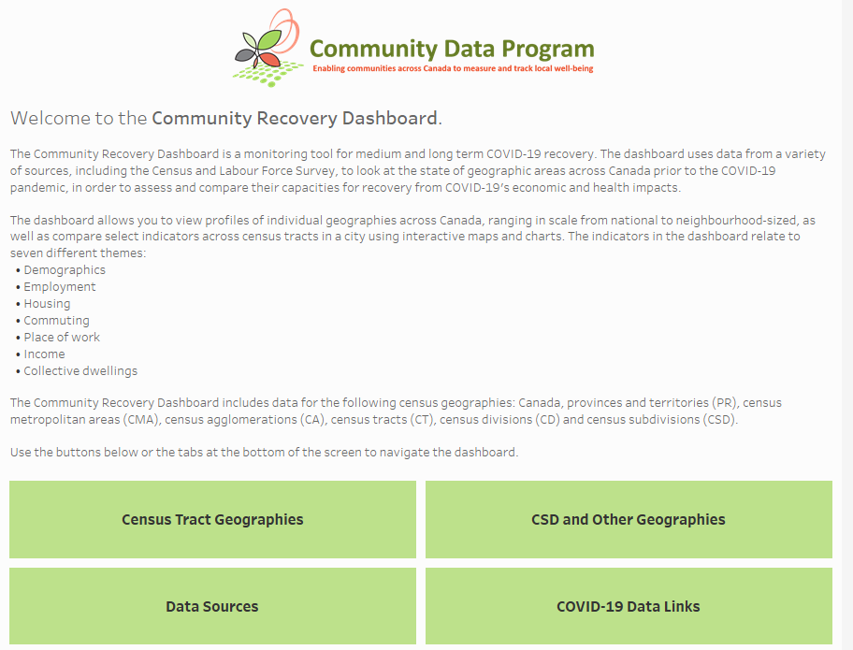
Sample dashboard
Community recovery dashboard
What could a Housing Data dashboard include?

Slide 40
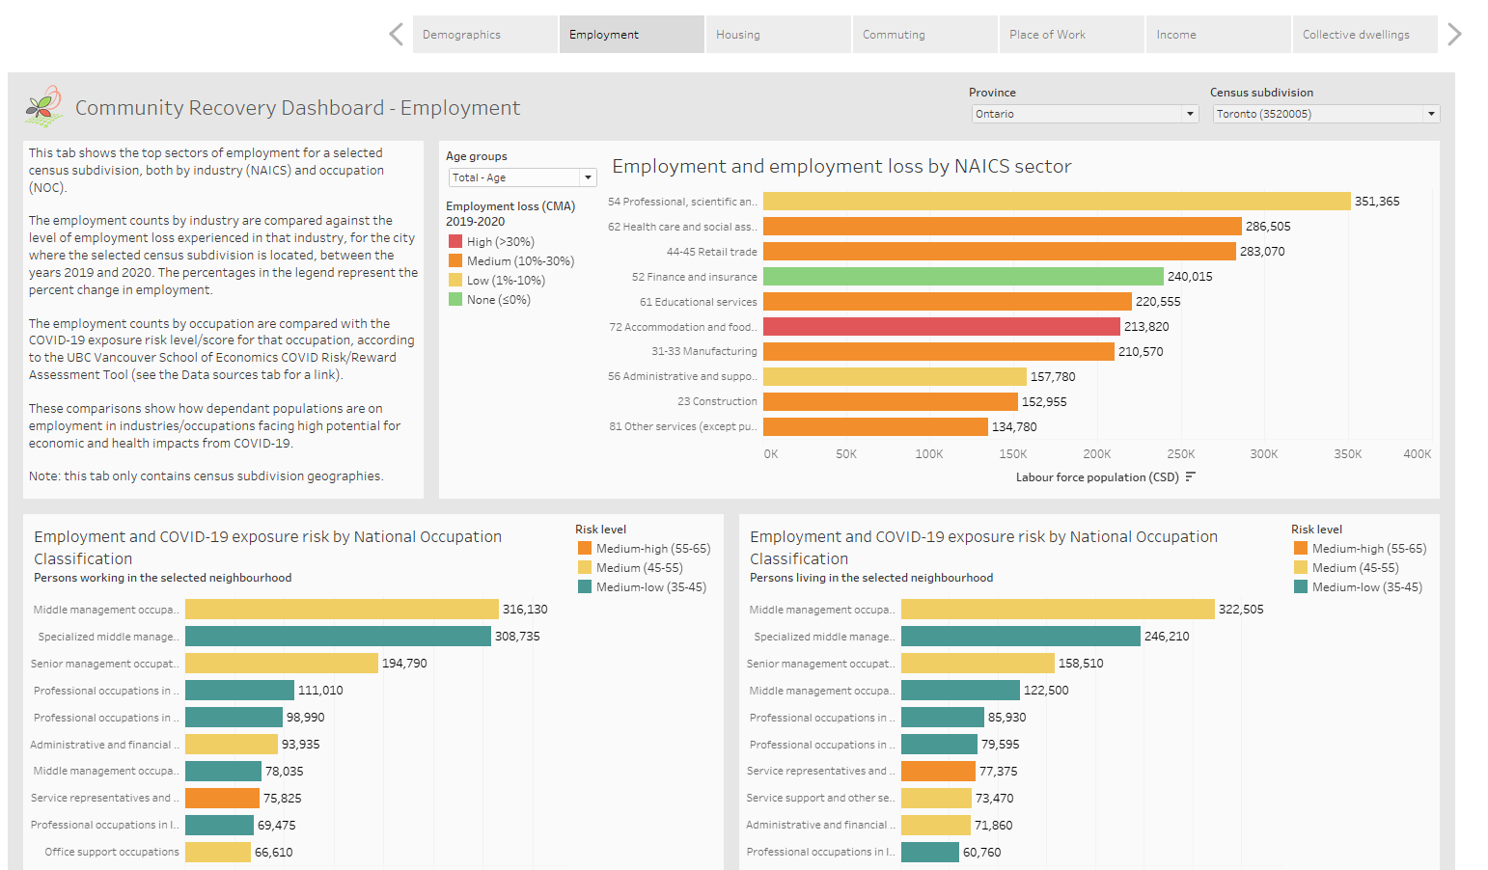

Slide 42
